Slide 1
Section 12.8
Linear Programming
Copyright © 2012 Pearson Education, Inc. Publishing as Prentice Hall.

Slide 2
Copyright © 2012 Pearson Education, Inc. Publishing as Prentice Hall.

Slide 3


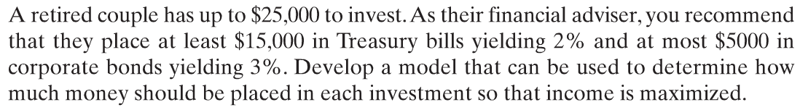
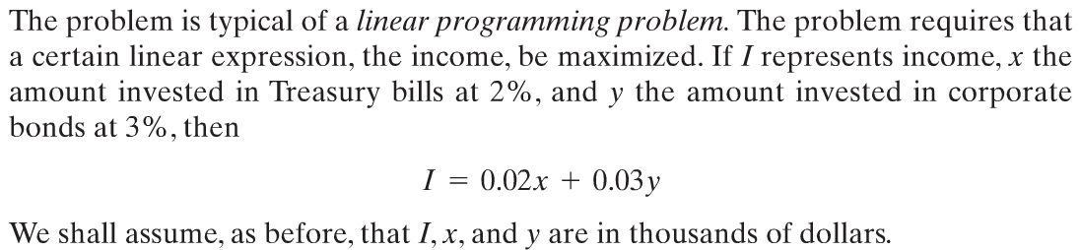
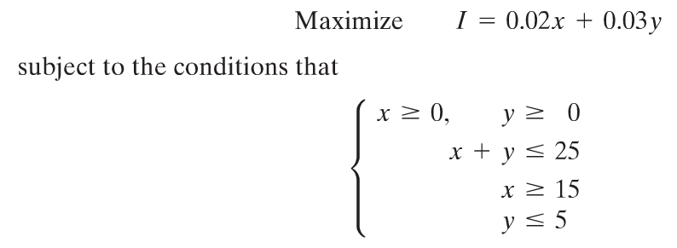
Copyright © 2012 Pearson Education, Inc. Publishing as Prentice Hall.

Slide 4
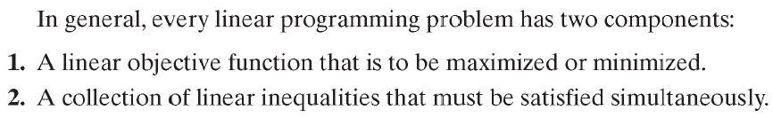
Copyright © 2012 Pearson Education, Inc. Publishing as Prentice Hall.

Slide 5

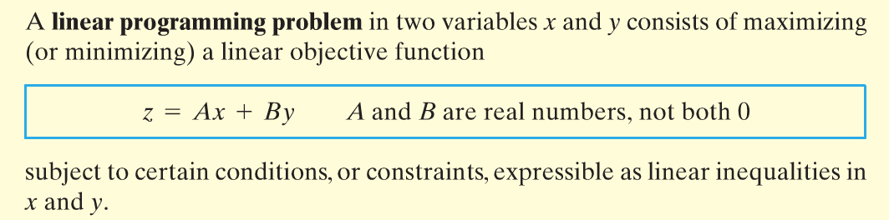
Copyright © 2012 Pearson Education, Inc. Publishing as Prentice Hall.

Slide 6
Copyright © 2012 Pearson Education, Inc. Publishing as Prentice Hall.

Slide 7
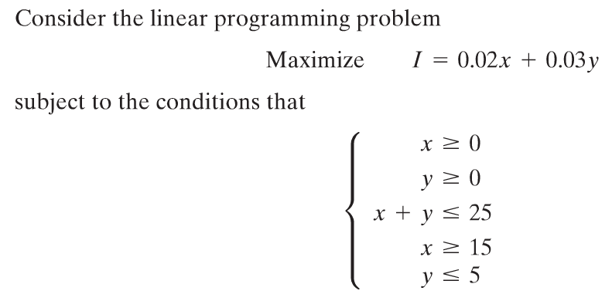
Copyright © 2012 Pearson Education, Inc. Publishing as Prentice Hall.

Slide 8
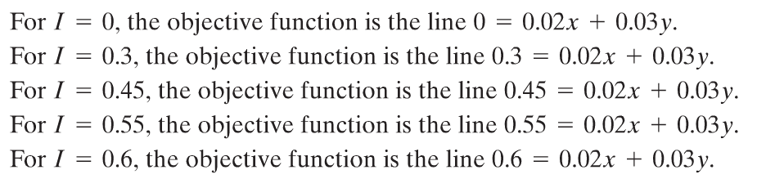
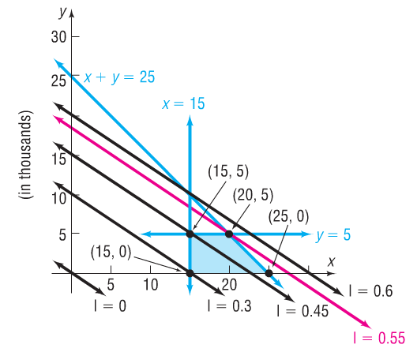
Copyright © 2012 Pearson Education, Inc. Publishing as Prentice Hall.

Slide 9

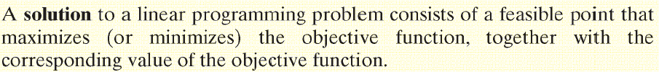
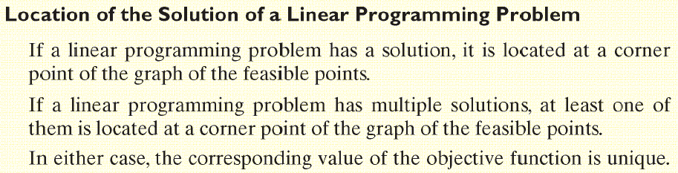
Copyright © 2012 Pearson Education, Inc. Publishing as Prentice Hall.

Slide 10
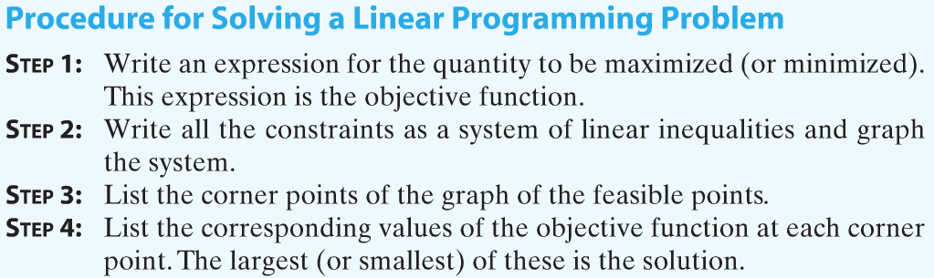
Copyright © 2012 Pearson Education, Inc. Publishing as Prentice Hall.

Slide 11
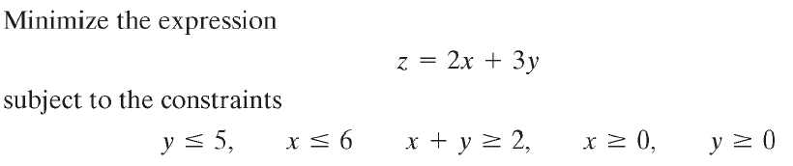
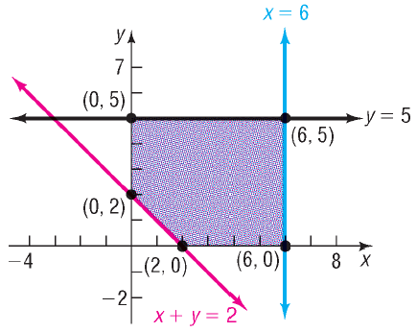
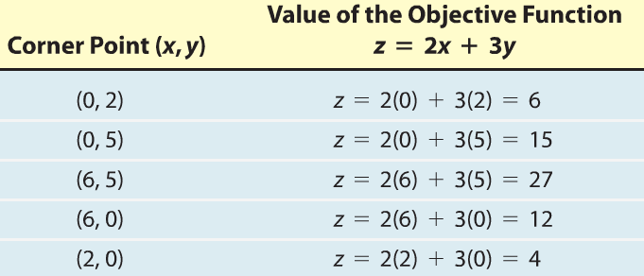
minimum
Copyright © 2012 Pearson Education, Inc. Publishing as Prentice Hall.

Slide 12

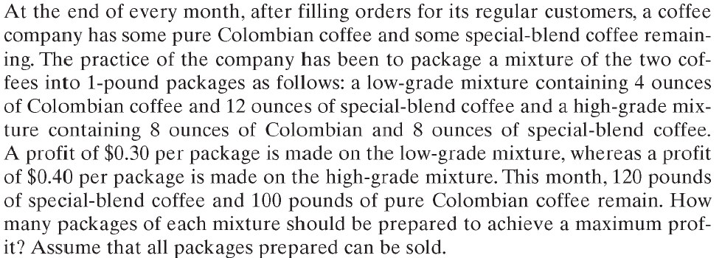





Copyright © 2012 Pearson Education, Inc. Publishing as Prentice Hall.

Slide 13
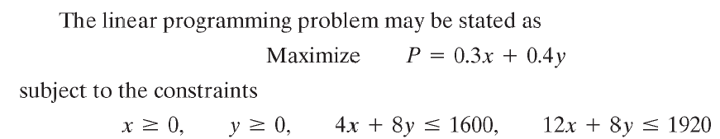
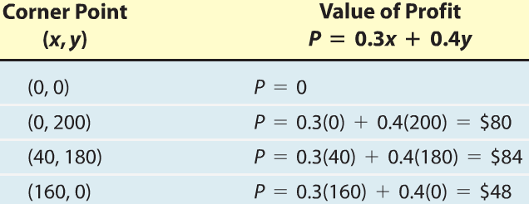
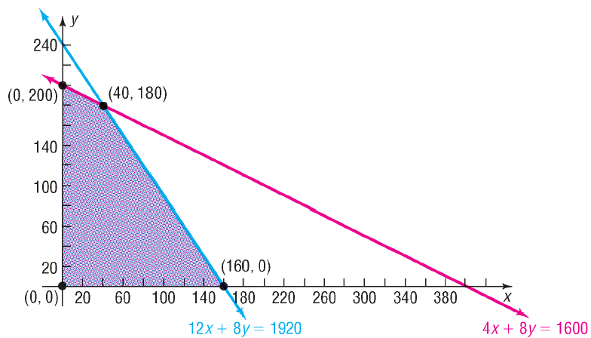
maximum
Copyright © 2012 Pearson Education, Inc. Publishing as Prentice Hall.

